Slide 1
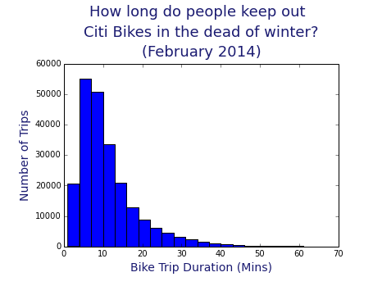

Slide 2
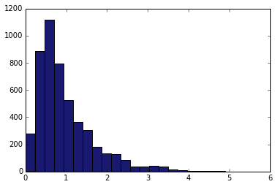
How far do they go?
Number of people
Miles between bike stations

Slide 3
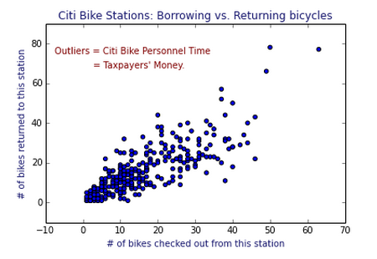

Slide 4
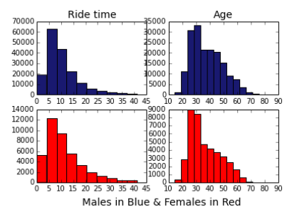

Slide 5
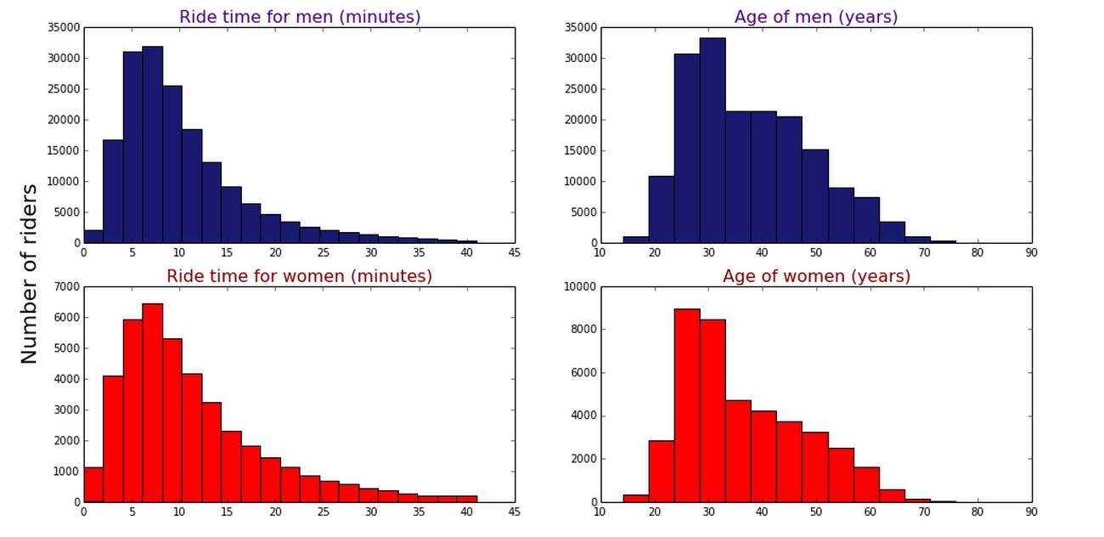

Slide 6
The slide show over is over.

Slide 7
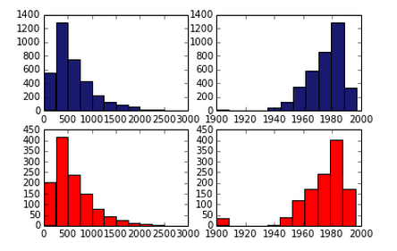

Slide 8
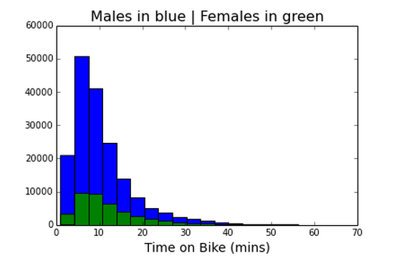

Slide 9
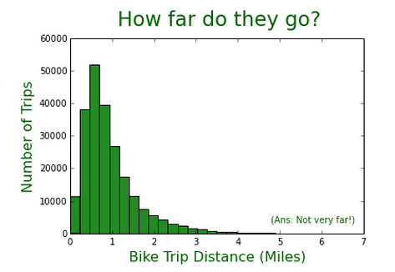

Slide 10
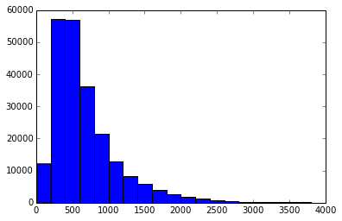
How long do people keep out citi bikes in the dead of winter?
(February 2014)
Number of people
Time with bike (in seconds)

Slide 11
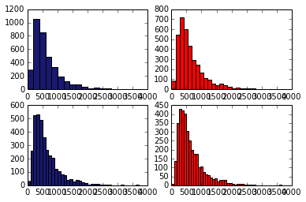
Don’t these look like
they could be 4 different things?
Guys spending time on bikes
They aren’t.

